Slide 1
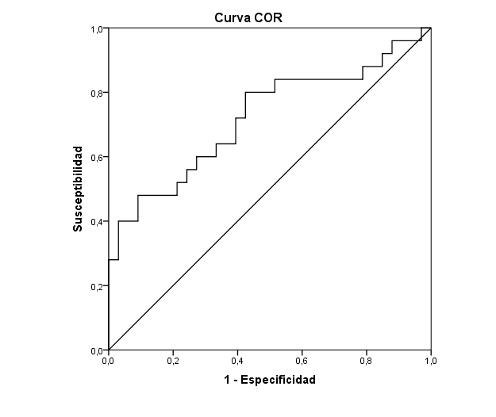
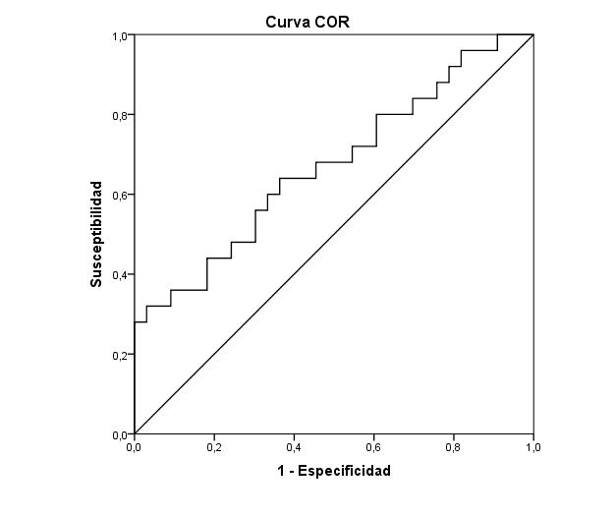
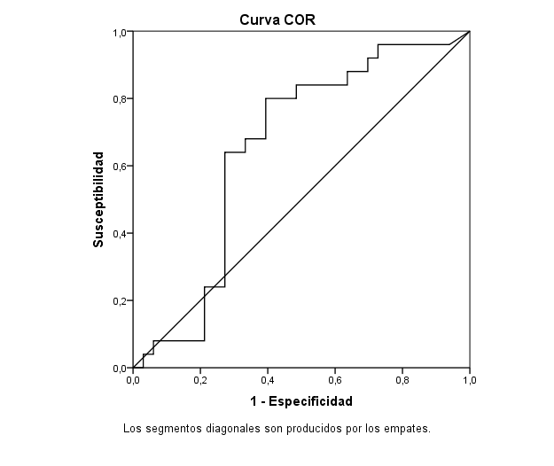
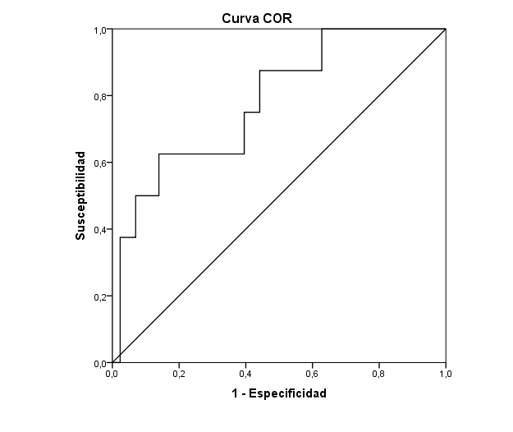
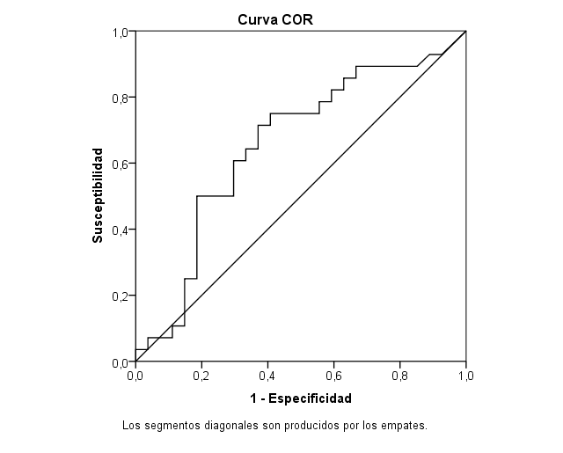
Urinary exosome-derived micro-RNAs as biomarkers for tenofovir disoproxil fumarate-associated (TDF) renal toxicity in HIV-1-infected patients
PEB 0127
Francisco Hernandez-Walias, Pilar Vizcarra, José M del Rey, Carmen Santiuste, Alejandro Vallejo, José L Casado
Dept of Infectious Diseases and Biochemistry, Ramon y Cajal Hospital, Madrid, Spain.
Background
Long-term use of antiretroviral therapy (cART) in aged HIV-1-infected individuals could enhance the incidence of clinical manifestations such as chronic kidney disease (CKD). Specifically, the use of TDF has been associated with increased kidney function deterioration, but recent studies did not find an increased rate of renal disease in patients with low risk for renal involvement or in those receiving non-boosted cART.
However, the incidence, severity, and outcome of TDF-associated renal toxicity is yet controversial and therefore, the use of sensitive biomarkers for renal toxicity and risk of renal deterioration/CKD diagnosis is still needed.
MicroRNAs (miRNAs) are endogenously produced, short RNAs of 21–25 nucleotides that do not code for proteins, but regulate their expression levels via post-transcriptional regulation. In kidneys, micro (mi)RNAs are indispensable for its development and homeostasis. Aberrant miRNA expression is observed in the mouse models of kidney fibrosis. The identification of those miRNAs in renal fibrosis may lead to breakthroughs in the development of novel diagnostic tools and therapeutic targets for the treatment of kidney fibrosis.
Objective
The aim of this study was to identify the usefulness of urinary exosome-derived miR expression profiles among patients under TDF-based ART to identify those with tubular dysfunction or renal function deterioration, and their predictive value after 9 months for progression to tubular dysfunction and subsequent renal function alteration.
Results
Overall, median time on TDF was 65 months (38-82.6), and mean eGFR was 90.9 ml/min/1.73m2 (50.1-122; 6% of patients with CKD). Tubular dysfunction was found in 25 patients. TD was more frequent in women who had TD (p=0.014). Individuals with TD had longer time of HIV-1 diagnosis (p=0.015). Of note, there were longer time on TDF in patients with a TD diagnosis. Individuals with TD had anti-HCV antibodies more frequently than those without TD (p=0.031). Similar plasma zenith HIV-1 RNA load, nadir CD4 count, and CD4 count at the moment of the study were found between both groups of individuals (p=0.865, p=0.313, and p=0.304, respectively). As it could be expected, individuals with TD showed a worse renal situation, with higher levels of serum cystatin C (p=0.003), lower GFR levels (p=0.003), and significant dysregulation of several tubular parameters and biomarkers.
A profile of 7 miR were finally evaluated. Statistically significant correlations among miRs are shown in figure 1, especially significant for miR 127 and miR 107, and miR let-7-d and miR 23a. Of note, the levels of miR-Let7d, miR-203, and miR-29a were upregulated in patients with a longer time on TDF (p=0.049, p=0.008, and p=0.020, respectively), while miR-127 was signifciantly downregulated (p=0.009), as shown in figure 2.
Decreased levels of miR-Let7d, miR-107, and miR-423 were found among individuals with TD (p=0.026, p=0.049, p=0.050, respectively), with intermediate AUC of 0.672, 0.652 and 0.652, respectively, as shown in Figure 3. Interestingly, the combination of the three miRs showed a good AUC of 0.721, with a sensitivity of 80% (95%CI 64.3-95.7) and a specificity of 57.6% (95%CI 40.7-74.4), as shown in Figure 4. The moderate predictive value for this combination was 1.886 and the negative predictive value was 0.347. Also, as shown in Figure 5, miR-Let7d and miR-29a negatively correlated with GFR-Cystatin C levels, while miR-15b positive correlated.
p=0,026
miR-Let7d
Combination of
miR-Let7d, miR-107, miR-423
miR-Let7d
Sensitivity
With
TD
No
TD
p=0,026
Error=0,073
AUC=0,672 (95%CI 0,529-0,814]
Figure 4: Receiver operating characteristics (ROC) for the combination of miR-Let7d, miR-107 and miR-423 as diagnostic biomarker of TD.
1-Specificity
p=0,049
miR-107
miR-107
Sensitivity
p<0,001
R=-0,457
p=0,038
R=-0,280
Methods
This study was the continuation of a longitudinal observational study about TDF associated renal toxicity (NCT02209740), in which urine samples of all participants were archived for further analysis. Individuals who were excluded from this study were pregnant or lactating women and individuals receiving investigational, nephrotoxic, or other drugs known to impair the function of the multidrug resistant protein 4 (MRP4) involved in the active secretion of TDF in the tubular cells, including non-steroidal anti-inflammatory drugs (NSAIDs), phosphodiesterase-5 inhibitors or anticancer chemotherapy.
For the purpose of this substudy we selected urine samples of 70 random virologically suppressed Caucasian HIV-1-infected adult individuals, 61 of them on TDF for least one year of exposure.
This study was approved by our Institutional Review Board (EC 069/16), and performed according to the principles of the Declaration of Helsinki. Written informed consent was obtained from all the participants.
Laboratory measurements
Demographic data, route of HIV-1 transmission, time of HIV-1 diagnosis, type and time under cART, hepatitis C virus (HCV) coinfection, had been collected from all individuals. CD4 T cell counts and serum HIV-1 RNA levels (Versant HIV-1 RNA 1.0 (kPCR), Siemens Diagnostics, Erlangen, Germany; detection limit of 37 RNA copies/mL) were also recorded.
At the study serum biomarkers such as glucose, creatinine, cystatin C, phosphate, chronic kidney disease (CKD-EPI cystatin C), and estimated glomerular filtration rate (eGFR cystatin C) were analyzed. Urine biomarkers including total protein, albumin, creatinine, phosphate, and glucose were analyzed. Other urine biomarkers were expressed as a ratio to urine creatinine such as cystatin C/creatinine, protein/creatinine, albumin/creatinine, retinol binding protein/creatinine, β2-microglobulin/creatinine, and N-acetyl-glucosaminidase/creatinine ratios.
In this study, renal tubular dysfunction (TD) was defined as the presence of at least two tubular abnormalities known to be part of Fanconi’s syndrome (nondiabetic glycosuria, hyperuricosuria, and/or proteinuria). Since hypophosphatemia could be related to phosphaturia, serum phosphate was not included in the definition. Renal function impairment was defined as an eGFR cystatin C <90 mL/min/1.73 m² or a reduction of eGFR cystatin C value after 9 months of follow up.
Urine samples and isolation of urinary exosomes
Urine samples were collected from all individuals and kept frozen at -80ºC until further analysis. Urine samples were thawed and sequentially centrifuged to remove debris and large particles, as described previously [37]. Briefly, urine samples were centrifuged at 2,000 g for 15 min at room temperature and then at 10,000 g for 30 min at room temperature. Supernatants were then centrifuged at 100,000 g for 60 min at 4ºC, and the pellet was washed with phosphate-buffered saline (PBS). Samples were subsequently treated with DNase to prevent DNA contamination, and filtered through a 200 nm pore syringe filter to eliminate larger vesicles such as large extracellular vesicles and apoptotic bodies. Exosomes were then precipitated using the miRCURY Exosome isolation kit (Exiqon A/S, Vedbaek, Denmark) and analysed to control the purity and yield by quantification for exosome content by the ExoELISA-ULTRA CD63 assay (SBI System Bioscience, Mountain View, CA, USA).
RNA extraction from urinary exosomes and quantification of miRs
RNA was extracted from isolated exosome-enriched pellets using the miRCURY RNA isolation kit-Biofluids (Exiqon A/S), and UniSp2-4-5 RNA templates were added as an internal control according to the manufacturer`s instructions. The concentration and purity of eluted RNA were analyzed with the NanoDrop instrument (Thermo Scientific). All RNA samples with 260/280 ratio between 1.8 to 2.0 and 260/230 ratio near 2.0 were considered suitable for further analyses. Ten nanograms of RNA was reverse transcribed in 15 µl reactions (miRCURY LNA Universal RT microRNA PCR, Exiqon A/S), including the UniSp6 RNA spike-in template reaction control. The cDNA was used to run real-time qPCR reactions in triplicate using the ExiLENT SYBR Green Master Mix (Exiqon A/S).
Primers for hsa-miR-103a, hsa-miR-Let7i, and hsa-miR-191 were quantified as reference controls for the calculation of the relative concentration of the following miRs: hsa-miR-Let7d, hsa-miR-107-xp, hsa-miR-423-xp, hsa-miR-127-xp, hsa-miR-15b-xp, hsa-miR-203a-xp, hsa-miR-29a-xp, hsa-miR-23a-3p.
Thermocycler conditions included a hot start at 95ºC/10 min followed by 40 cycles of 95ºC/15 s and 60ºC/45 s using the LyghtCycler 480 II instrument (Roche, Basel, Switzerland). Amplification curves were analyzed using the Roche LightCycler 480 version 1.5.1.62 software. Reaction specificity was ascertained by the melt curve procedure. Ct values above 35 and a standard deviation between triplicates above 0.3 Ct were considered unreliable and were excluded from further analysis. The expression levels of single miRs relative to the mean reference miRs expression were calculated using the ΔCt method (Ct target miR minus mean references Ct) and are shown as log₂ 2^{-ΔCt} .
Statistical analysis
Continuous variables were expressed as the median and interquartile range (IQ₂₅₋₇₅) and categorical variables by frequencies and proportions. For comparison, we divided patients at baseline according to the diagnosis of tubular dysfunction. Comparison of categorical variables were performed using chi-square distribution, while comparison of continuous variables were analyzed using nonparameteric Mann-Whitney U test. Spearman's rank correlation coefficient was used to measure the association between two variables. Receiver operating characteristic (ROC) curve analysis was performed to evaluate the discrimination threshold (with 95% confidence intervals) of the variables. Two-sided test was used for all statistics and p<0.05 was considered statistically significant. Data analysis was performed using Statistical Package for the Social Sciences Software (SPSS Version 22.0, Chicago, Illinois).
With
TD
No
TD
p=0,049
Error=0,074
AUC=0,652 [95%CI 0,560-0,798]
GFR-CysC
p<0,001
R=0,544
p<0,001
R=0,803
p=0,031
R=0,284
p=0,050
1-Specificity
p=0,041
R=0,277
miR-23a
miR-107
miR-203a
miR-423
miR-Let7d
miR-29a
miR-15b
miR-Let7d
miR-127
miR-127
With
TD
No
TD
Figure 5: Correlations with statistic significance between relative expression levels of miRs (Log₂ 2^{-ΔCt}) and the estimated glomerular filtration rate (eGFR)
p=0,001
R=0,433
p=0,006
R=0,354
p=0,001
R=-0,426
Figure 3: Differences of the relative expression levels of miRs (log₂ 2^{-ΔCt}) between HIV-1-infected individual with tubular dysfunction (TD) and with no TD (left side).
miR-423
miR-29a
miR-15b
Predictive value of urine exosome-derived miRs for tubular dysfunction and renal function alterations
After a median follow up of 9 months [IQR 4-12.7], In a ROC analysis, miR-Let7d predicted future TD (p=0.012) with an AUC of 0.782, as shown in Figure 7A. This miR showed a positive predictive value of 66.7% and a negative predictive value of 68%.
On the other hand, miR-23a showed a moderate predictive value for eGFR decrease with an AUC of 0.655, with a sensitivity of 71.4% (95%CI 54.7-88.2) and a specificity of 63.0% (95%CI 44.7-81.2), as shown in Figure 7B. This miR showed a positive predictive value of 66.7% and a negative predictive value of 68%.
miR-203a
miR-203a
miR-29a
Figure 1: Correlations with statistic significance among relative expression levels (Log₂ 2^{-ΔCt}) of miRs of the 58 HIV-1-infected individual included in the study. Significant when p>0.050.
Figure 7: A. Differences of the relative expression levels of miR-Let7d (log₂ 2^{-ΔCt}) between individuals with tubular dysfunction (TD) and with no TD (left side) after a median time of follow up of 9 months. Receiver operating characteristics (ROC) curve showing the fraction of true positive results (sensitivity) and false positive results (1-specificity) for levels of miR-Let7d as prognostic biomarker of TD is shown at the right side. The calculated área under the curve (AUC), 95% confidence interval (CI), p value, and analysis error are shown. Significant when p<0.050. B. Differences of the relative expression levels of miR-23a (log₂ 2^{-ΔCt}) between individuals who had GFR decrease and individuals who had not (left side) after a median time of follow up of 9 months. Receiver operating characteristics (ROC) curve showing the fraction of true positive results (sensitivity) and false positive results (1-specificity) for levels of miR-23a as predictive biomarker of GFR deterioration is shown at the right side. The calculated área under the curve (AUC), 95% confidence interval (CI), p value, and analysis error are shown. Significant when p<0.050.
A
p=0,012
miR-Let7d
p=0,049
R=0,260
miR-Let7d
p=0,009
R=-0,339
miR-127
Discrimina Tubular dysfunction
en tiempo 2
miR-Let7d
Sensitivity
Relative expression
(log₂ 2^{-ΔCt})
Relative expression
(log₂ 2^{-ΔCt})
AUC= 0,782 [0,612-0,952]
p=0,012
Error=0,087
With
TD
No
TD
1-Specificity
B
p=0,048
p=0,008
R=0,345
miR-203
p=0,020
R=0,305
miR-29a
Discrimina CKD EPI decrease
en tiempo 2
miR-23a
Sensitivity
Relative expression
(log₂ 2^{-ΔCt})
Relative expression
(log₂ 2^{-ΔCt})
AUC= 0,655 [0,506-0,805]
p=0,048
Error=0,076
GRF
decrease
No
GFR
decrease
1-Specificity
Time under TDF-based ART
Conclusions
The expression profile of miRs was altered in urinary exosomes from patients with TDF-associated toxicity. We identified exosome-derived miRs in urine that could be used as non-invasive biomarkers for the detection of renal toxicity associated with TDF.
Figure 2: Correlations of miRs with the time of exposure to TDF-based ART
PRESENTED AT THE 23RD INTERNATIONAL AIDS CONFERENCE (AIDS 2020) | 6-10 JULY 2020

